Slide 1
Programming the arduino
Cary area public library

Slide 2
introduction
Ryan Brock
Software Engineer – 15 Years
Purdue University – Computer Science
Motorola
Zebra Technologies

Slide 3

contact
Twitter: @borq79
Email: borq79@gmail.com
Github Repo: https://github.com/borq79/cs.edu
Google Discussion Group: https://groups.google.com/forum/#!forum/cary-area-computer-science-education

Slide 4

goals
Learn how to use the Arduino IDE
Learn how to upload programs to the Arduino Uno
Learn how to debug the Arduino Uno
Learn how to interface with hardware

Slide 5

Agenda
why arduino?
explore the arduino ide
Install some additional libraries
setup vs. loop
input and output
debugging via the console / terminal / serial monitor
arduino and time
interfacing with hardware
doing this at home

Slide 6
Why Arduino?
Great Teaching Tool
Variety
Easy to get started
No OS to get in the way
Device control
Physically small
But note, not lots of memory or processing power

Slide 7
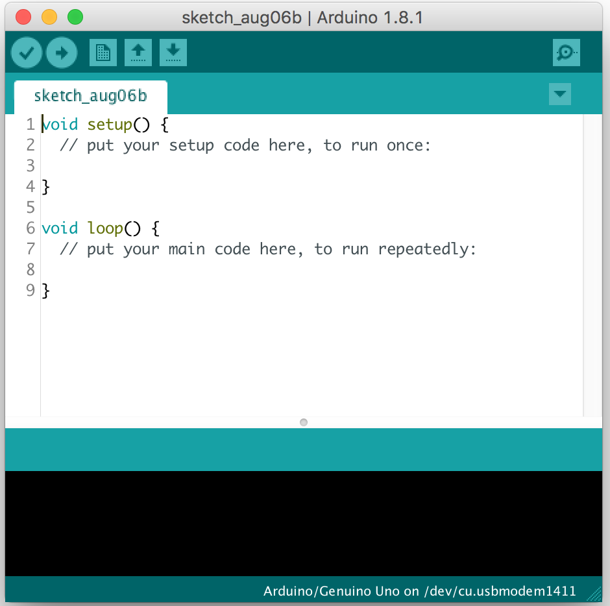
Open the IDE
look for the Arduino IDE icon on the desktop
double click it and wait for it to open
a new ‘sketch’ (program) should come up with a setup and loop function
verify
upload
compiler output window
board / port / serial monitor / serial plotter

Slide 8

What are libraries?
borrowed code
reuse
hardware manufacturers
open source
Platforms / architectures

Slide 9

Adding libraries
go to sketch -> include library -> manage libraries
search for the library needed and click install
go to sketch -> include library -> add .zip library

Slide 10

Setup vs loop
setup()
one time at power up
initialize hardware, variables, etc.
loop()
continuous loop
main program
restarts at the top each time

Slide 11
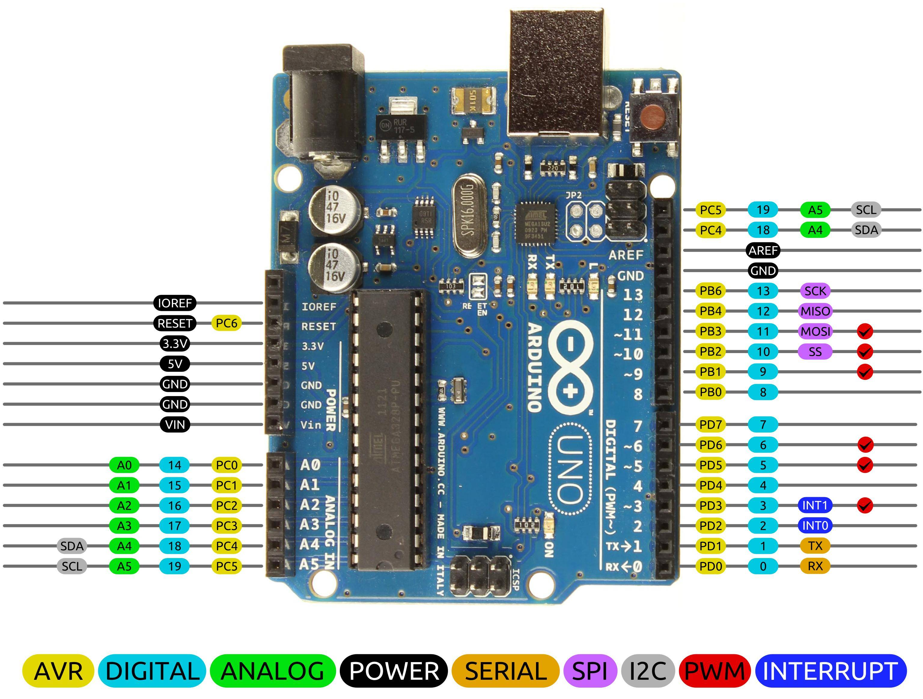
Input and output
Pins
input – read values / data / sensors
output – drive motor / speaker / light
network interface
pull-up resistors
analog and digital
pwm

Slide 12

pwm
duty cycle
on and off
LED brightness

Slide 13

debugging
no monitor or display
use serial port to print to serial monitor
use LEDs to indicate position in program

Slide 14
Breadboards
Power and ground rows
Columns are connected
Two sides – gap separated
Grid Layout
Can you Find C:19?

Slide 15
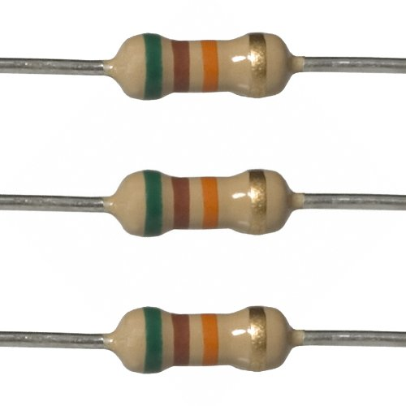
Resistors
Restrict current
Give off heat
Color bands indicate resistance

Slide 16
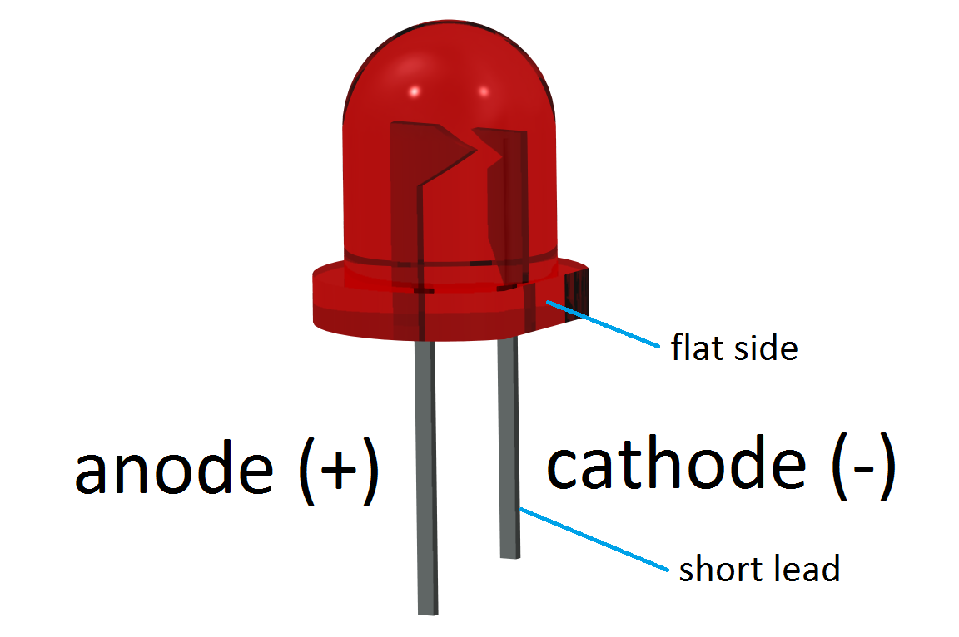
leds

Slide 17
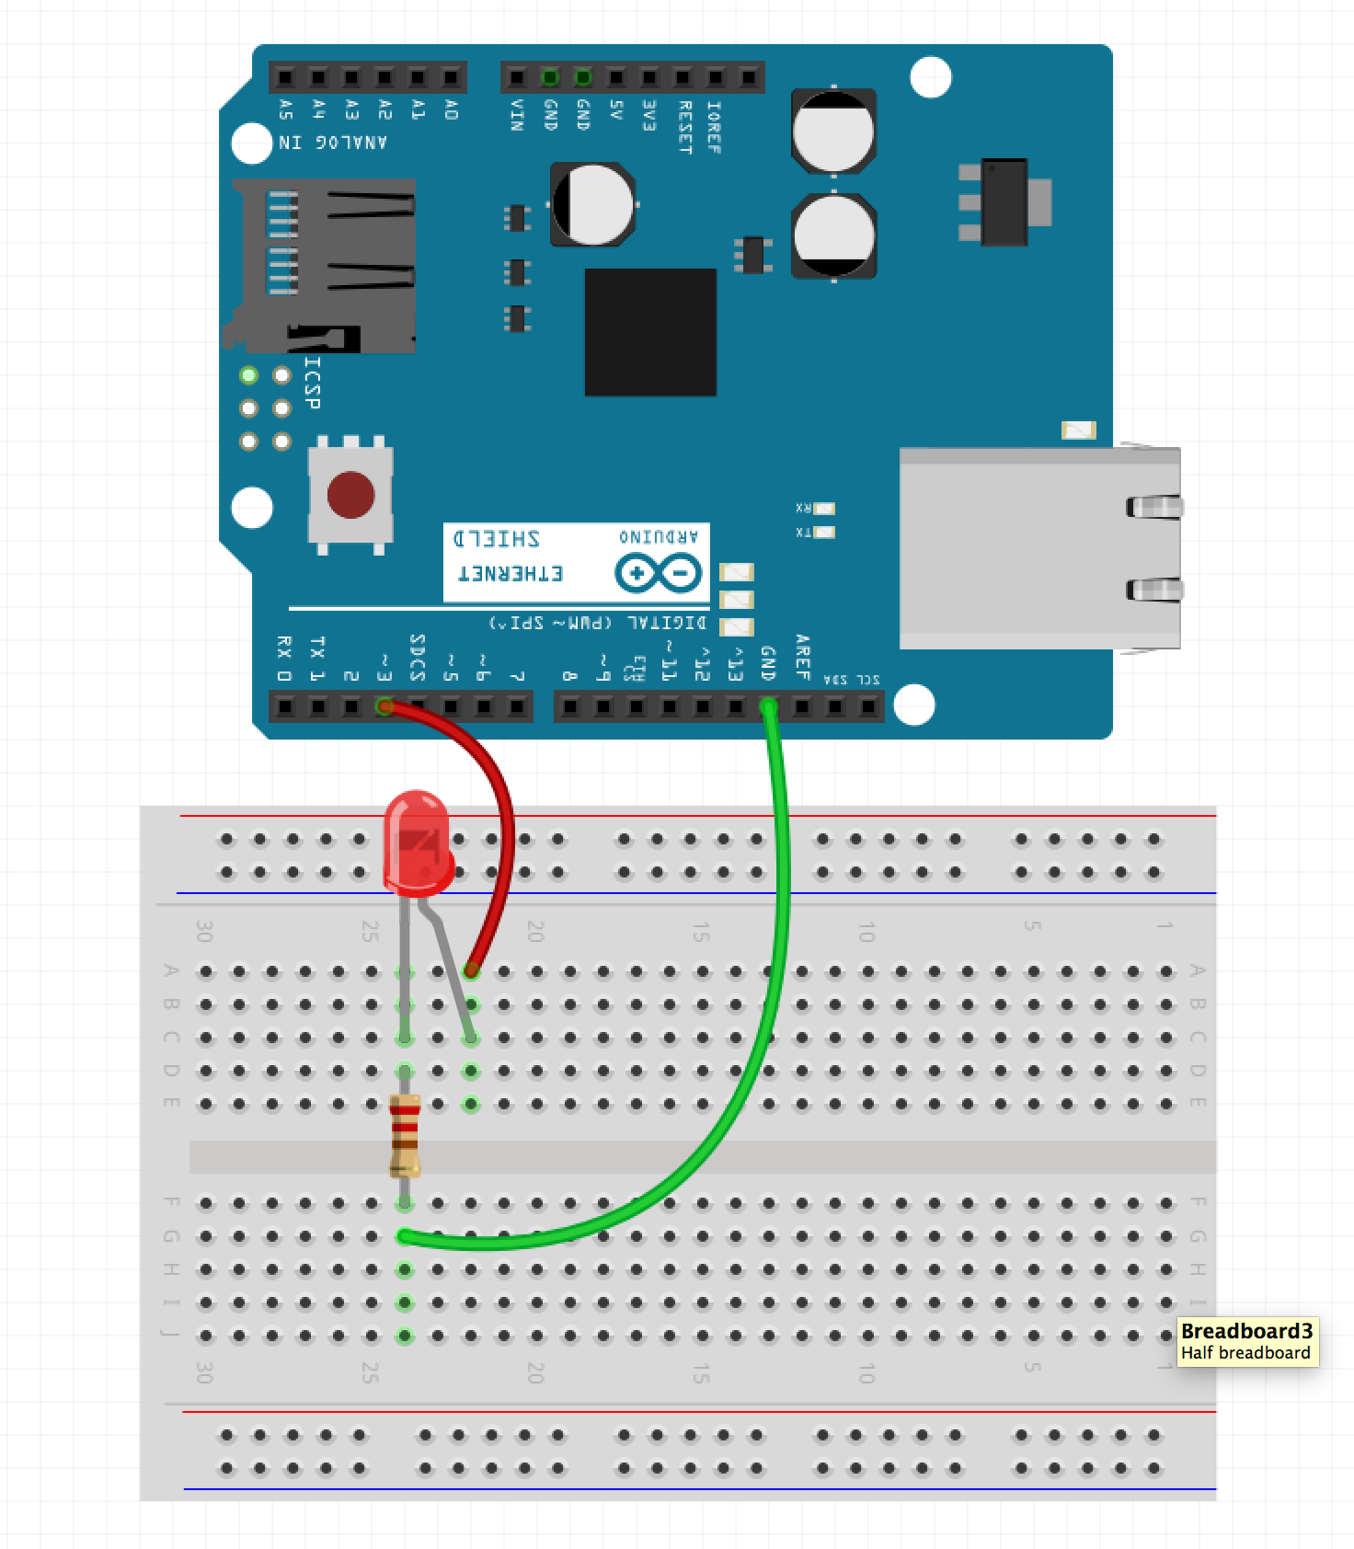
learned so far
resistor in D:26 and F:26
LED cathode in C:26
LED anode in C:22
red wire from pin 3 to A:22
green wire from G:26 to gnd
load program1.ino
verify
upload
set port
open serial monitor

Slide 18

Arduino and time
Millisecond delay
1 / 1,000 of a second
delay( 1000 );
Microsecond delay
1 / 1,000,000 of a second
delayMicroseconds( 1000000 );

Slide 19
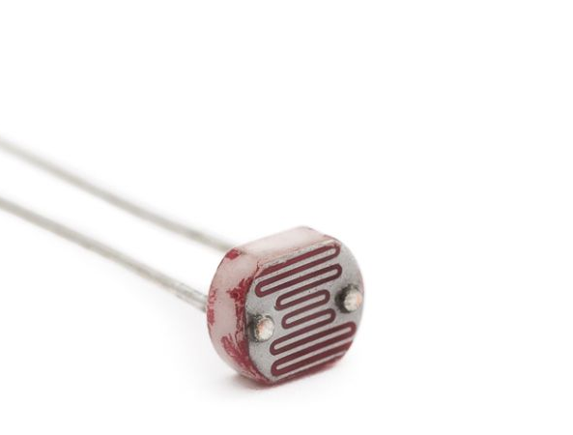
PhotoResistors
Change resistance based on light intensity
Voltage division

Slide 20

Voltage Division
V_{out} = (R₂ ÷ (R₁ + R₂)) * V_{in}

Slide 21
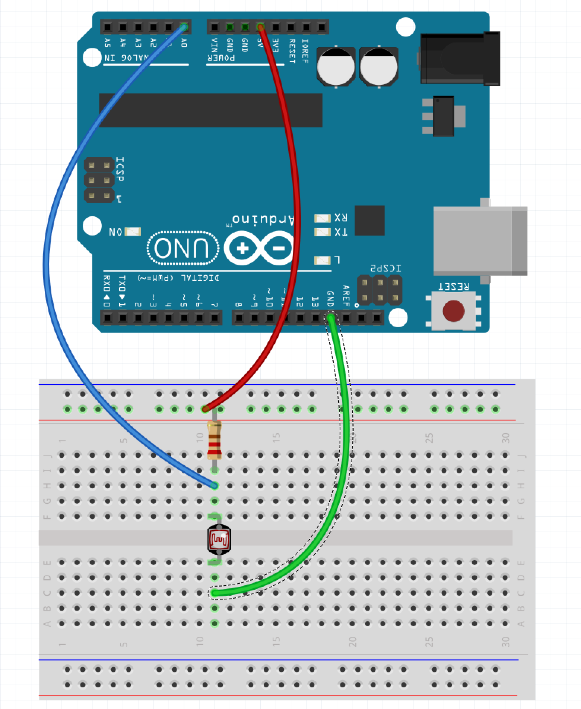
Read light intensity
330 Ω resistor
10K Ω resistor
photoresistor
3 male wires
330 Ω resistor in red row and I:11
photoresistor in F:11 and E:11
red wire from 5V to red row
green wire from C:11 to GND
blue wire from H:11 to A0
program2.ino
try 10K Ω resistor next

Slide 22
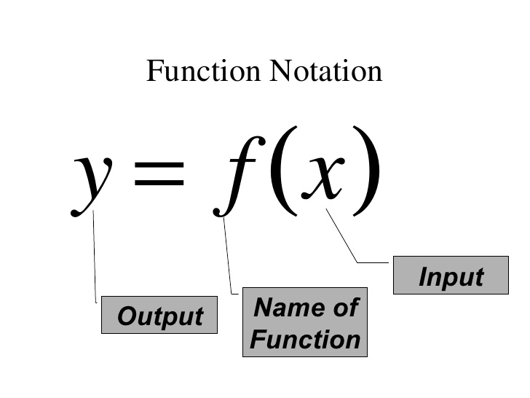
Functions
group code
reuse code
pass in variables
open program3.ino

Slide 23
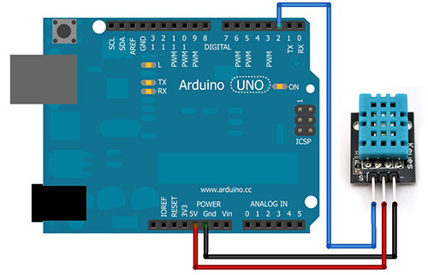
DHT11 Temperature and humidity sensor
3 Female-Male Wires
‘-’ to GND
‘S’ to pin 2
Middle pin to 5V
Load program 4.ino

Slide 24
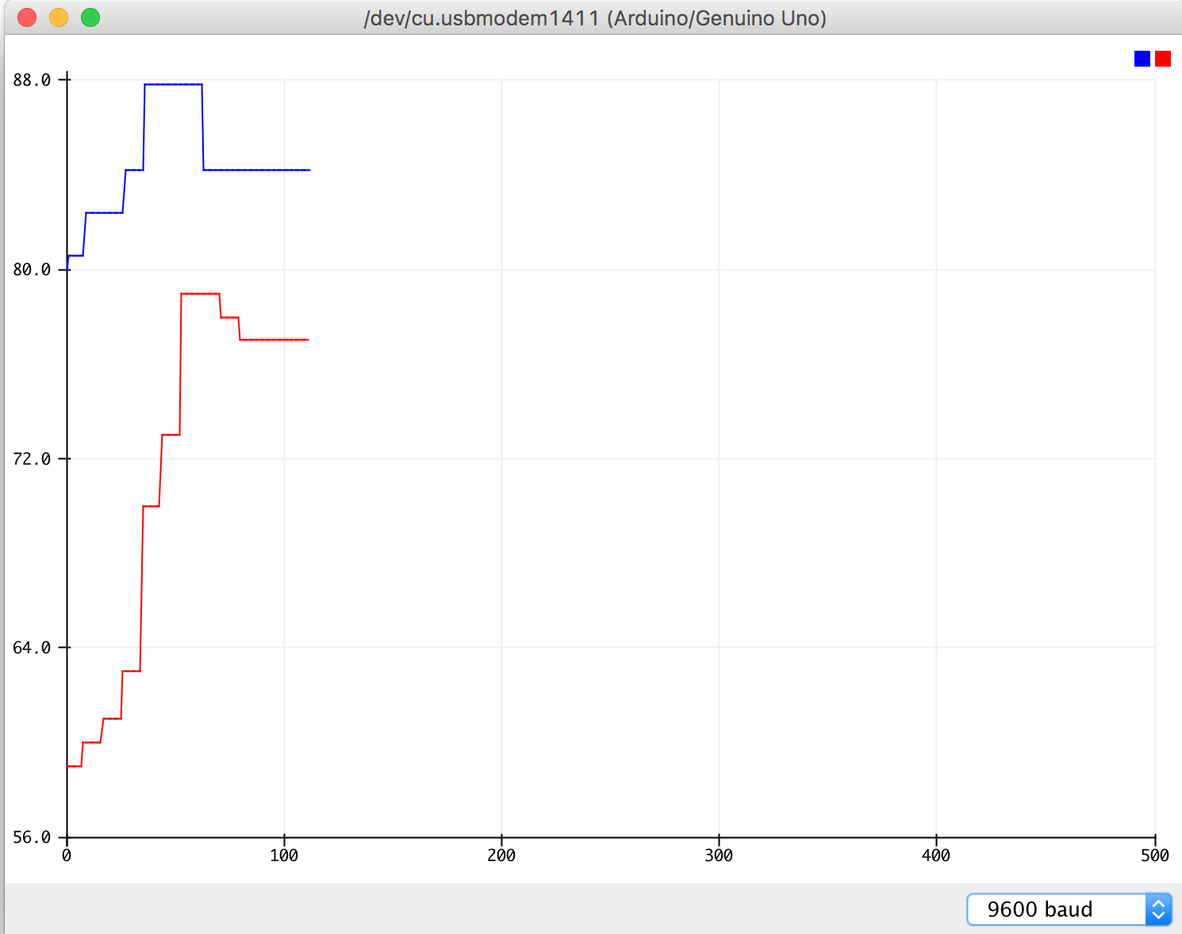
Serial plotter
Close serial monitor
Open serial plotter
plots values over time

Slide 25
Doing this at home
arduino ide is free
atom + platform.io
arduino uno + breadboard kits
some with sensors some with just basics
$15 and $19 kits …

